Slide 1


NAAN MUDHALVAN
DIGITAL
MARKETING
INSTAGRAM REEL

Slide 2


TEAM MEMBERS
01
DINESHKRISHNA H
02
HANANIAH SHADRACH D
03
VASAN V
04
MOHANA KRISHNAN H

Slide 3
INSTAGRAM REEL
Aim:
Create an Instagram reel for our business brand “ProGreeners” and promoted. It attracted a more than 248 Likes so for.

Slide 4
01
PROGREENERS
E-COMMERCE
PLATFORM
"ProGreeners" is an innovative agricultural e-commerce platform dedicated to providing a convenient and efficient online marketplace for farmers, agricultural enthusiasts, and businesses involved in the agriculture sector. This platform aims to streamline the process of buying and selling agricultural products and services. ProGreeners will offer a wide range of products, including seeds, fertilizers, tools, machinery, and even expert advice. It will facilitate a digital connection between farmers and suppliers, empowering them to make informed decisions, boost productivity, and contribute to the growth of the agricultural industry.

Slide 5

75%
25%
Percentage of the farmers facing the intermediater issues while selling their products it’s due to the marketing problem
Percentage of the farmers facing manufacturings issues,
it’s due to lack of communictions between the experts and farmers.

Slide 6
PROGREENERS THINKING
The Ultimate aim of the “ProGreeners” was to solve the current problems of farmers by
Creating the communication between the farmers and agricultural experts for solve the crop problems and converting it into a value added products.
Send their products without any intermediators ,so that they can fix their own cost for their products.
It can create a communication between the other farmers , so that deficiency and over cultivation should be avoided

Slide 7
GREATLY
HANDS-ON
ALWAYS
ITERACTIVE
GO BEYOND
LOOP THROUGH
You need the ability to look at all the different aspects of a problem.
The more you are able to loop through, the higher chance you have for good results.
02

Slide 8
HERE THE STEPS HOW WE DO IT ?
step 1 - created a Instagram account
step 2 - Make it as a professional account
step 3 - created a video about our project using “kinemaster”
step 4 - And uploaded it in our Instagram reels section , using trending hashtags with description
step 5 - Try to make it as maximum reach by organic and inorganic method
03

Slide 9
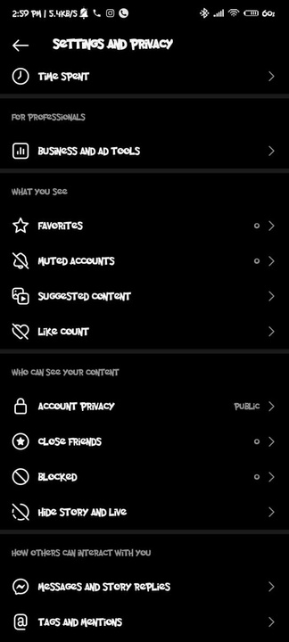

Creating a brand
and make a video for it
Create a public
account

Slide 10
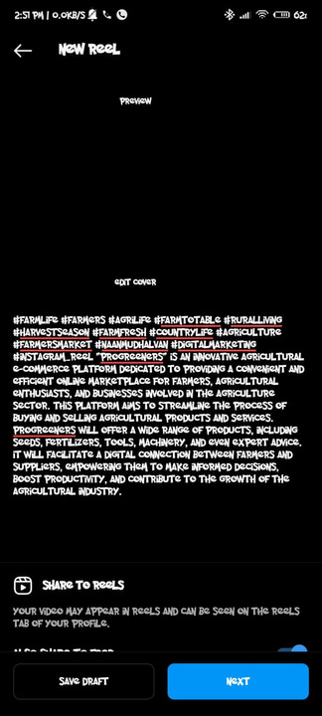
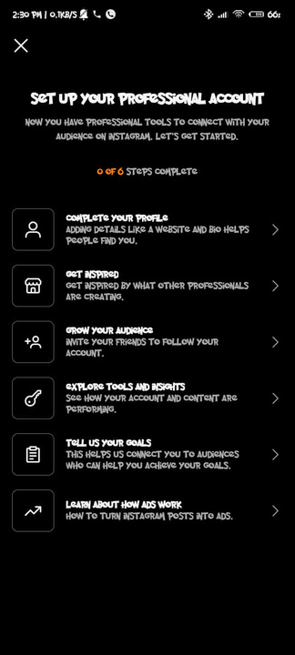
make the account as a
professional
upload the video and post it
in reels section

Slide 11
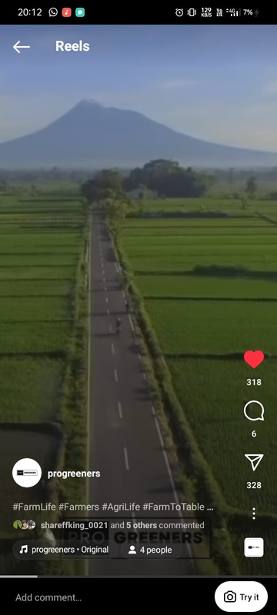
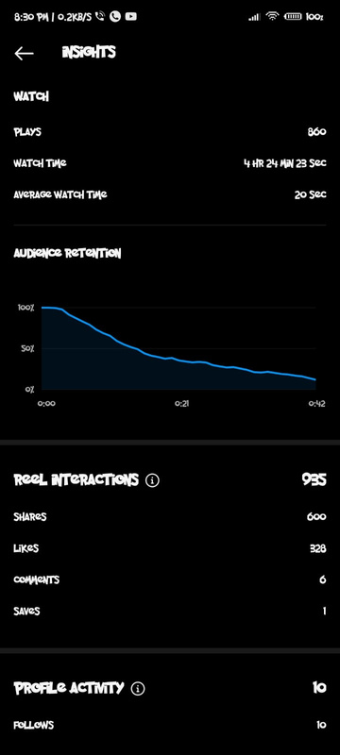
We reached 850+ viwers
and more than 300+ liked the video

Slide 12

BRAND NAME: PROGREENERS
Category: agriculture based e-commerce site
Target Audience: All (Men, Women and Kids)
Email : decidersCreations@gmail.com
PROGREENERS

Slide 13
THANKS
A LOT
BY TEAM MEMBERS

